Slide 1

Random Forest Algorithm
Nakisa Tavakoli

Slide 2
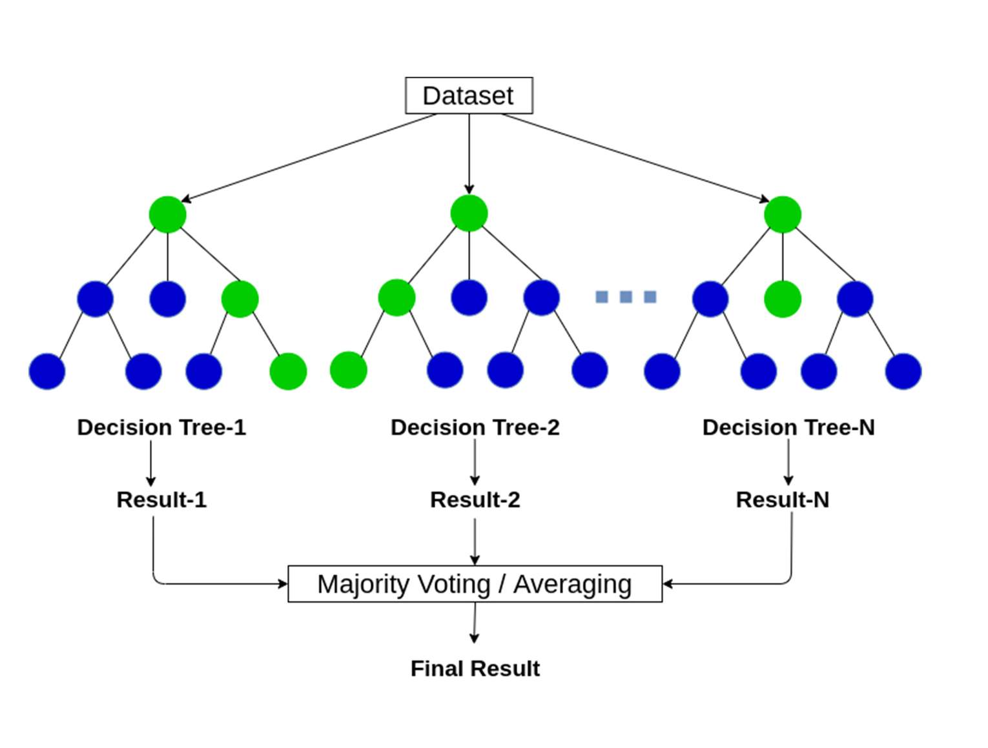
Random Forest Algorithm
A Random Forest is an ensemble learning method used for classification, regression, and other tasks that operates by constructing multiple decision trees during training and outputting the mode of the classes (classification) or mean prediction (regression) of the individual trees. It addresses the limitations of individual decision trees, such as overfitting, and generally provides better performance.

Slide 3
Random Forest Algorithm : How Random Forest Works
Bootstrap Sampling: Random subsets of the training data are created with replacement (bootstrap samples).
Tree Construction: For each bootstrap sample, a decision tree is built, but at each node, only a random subset of features is considered for splitting.
Ensemble of Trees: The forest consists of multiple such trees, each trained on different parts of the data.
Aggregation:
Classification: The final prediction is the majority vote of the individual trees.
Regression: The final prediction is the average of the predictions from all trees.

Slide 4
Random Forest Algorithm: Advantages
Reduction in Overfitting: Combining multiple trees reduces the risk of overfitting compared to individual trees.
Robustness: Effective in handling missing values and maintaining accuracy for missing data.
Versatility: Can be used for both classification and regression tasks.

Slide 5
Random Forest Algorithm: Disadvantages
Complexity: More computationally intensive and harder to interpret compared to a single decision tree.
Memory: Requires more memory due to the storage of multiple trees.

